Slide 1

Four Settings and an Intervention: Why some work and others fail?
Kamran Siddiqi, Department of Health Sciences, University of York
Heather Thompson, Leeds City Council

Slide 2

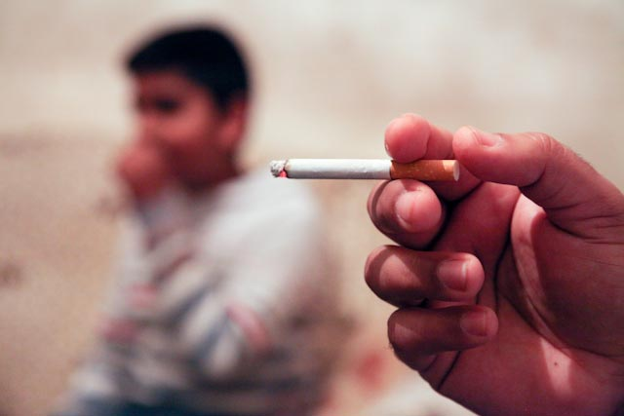
Second-hand smoking (SHS)
Well known facts
  600,000 deaths in the world
  In children, increased risk of respiratory tract, and middle ear infections, meningococcal disease, and asthma.
  In adults, cardiovascular diseases, chronic respiratory diseases, nasal and lung cancers

Slide 3
Second-hand smoking (SHS)
Less well-known facts
  75% of deaths are in women and children
  Risk of stillbirth, congenital malformation, and low-birth weight
  A third of non-smoking women worldwide could be exposed to SHS, the attributable risk in pregnancy could be even higher than active smoking
  Risk of TB disease

Slide 4
Tobacco-related health disparities
Target group
  Pregnancy
  Childhood
  Debilitating conditions (TB)
  Marginalised groups (BME)

Slide 5
Existing evidence
The evidence for smoke free homes is scarce
The effect of parental education and counselling programmes?
Non-smokers (children) to negotiate smoking restrictions?
Reduce SHS exposure at homes in antenatal settings?

Slide 6
Settings
After feasibility work in communities in Leeds and Lahore
Four studies
Children (CLASS) Bangladesh
Mothers (MLASS) UK
TB patients (TBLASS) Pakistan
Muslim communities (MCLASS) UK

Slide 7
Behaviour change (assumptions)
 | Facilitator of change | Agent of change | Settings | Target population | Study design
CLASS (Bangladesh) | School teacher | Children | Primary schools | Parents and other family members | RCT (pilot)
MLASS (UK) | Midwife & health visitors | Pregnant women | Antenatal appointments | Partners and other family members | Feasibility study
TBLASS (Pakistan) | Healthcare worker | TB patients | TB clinics | Partners and other family members | RCT (pilot)
MCLASS (UK) | Faith leaders | Faith leaders and their congregation | Mosques | Smokers and their family members | RCT (pilot)

Slide 8
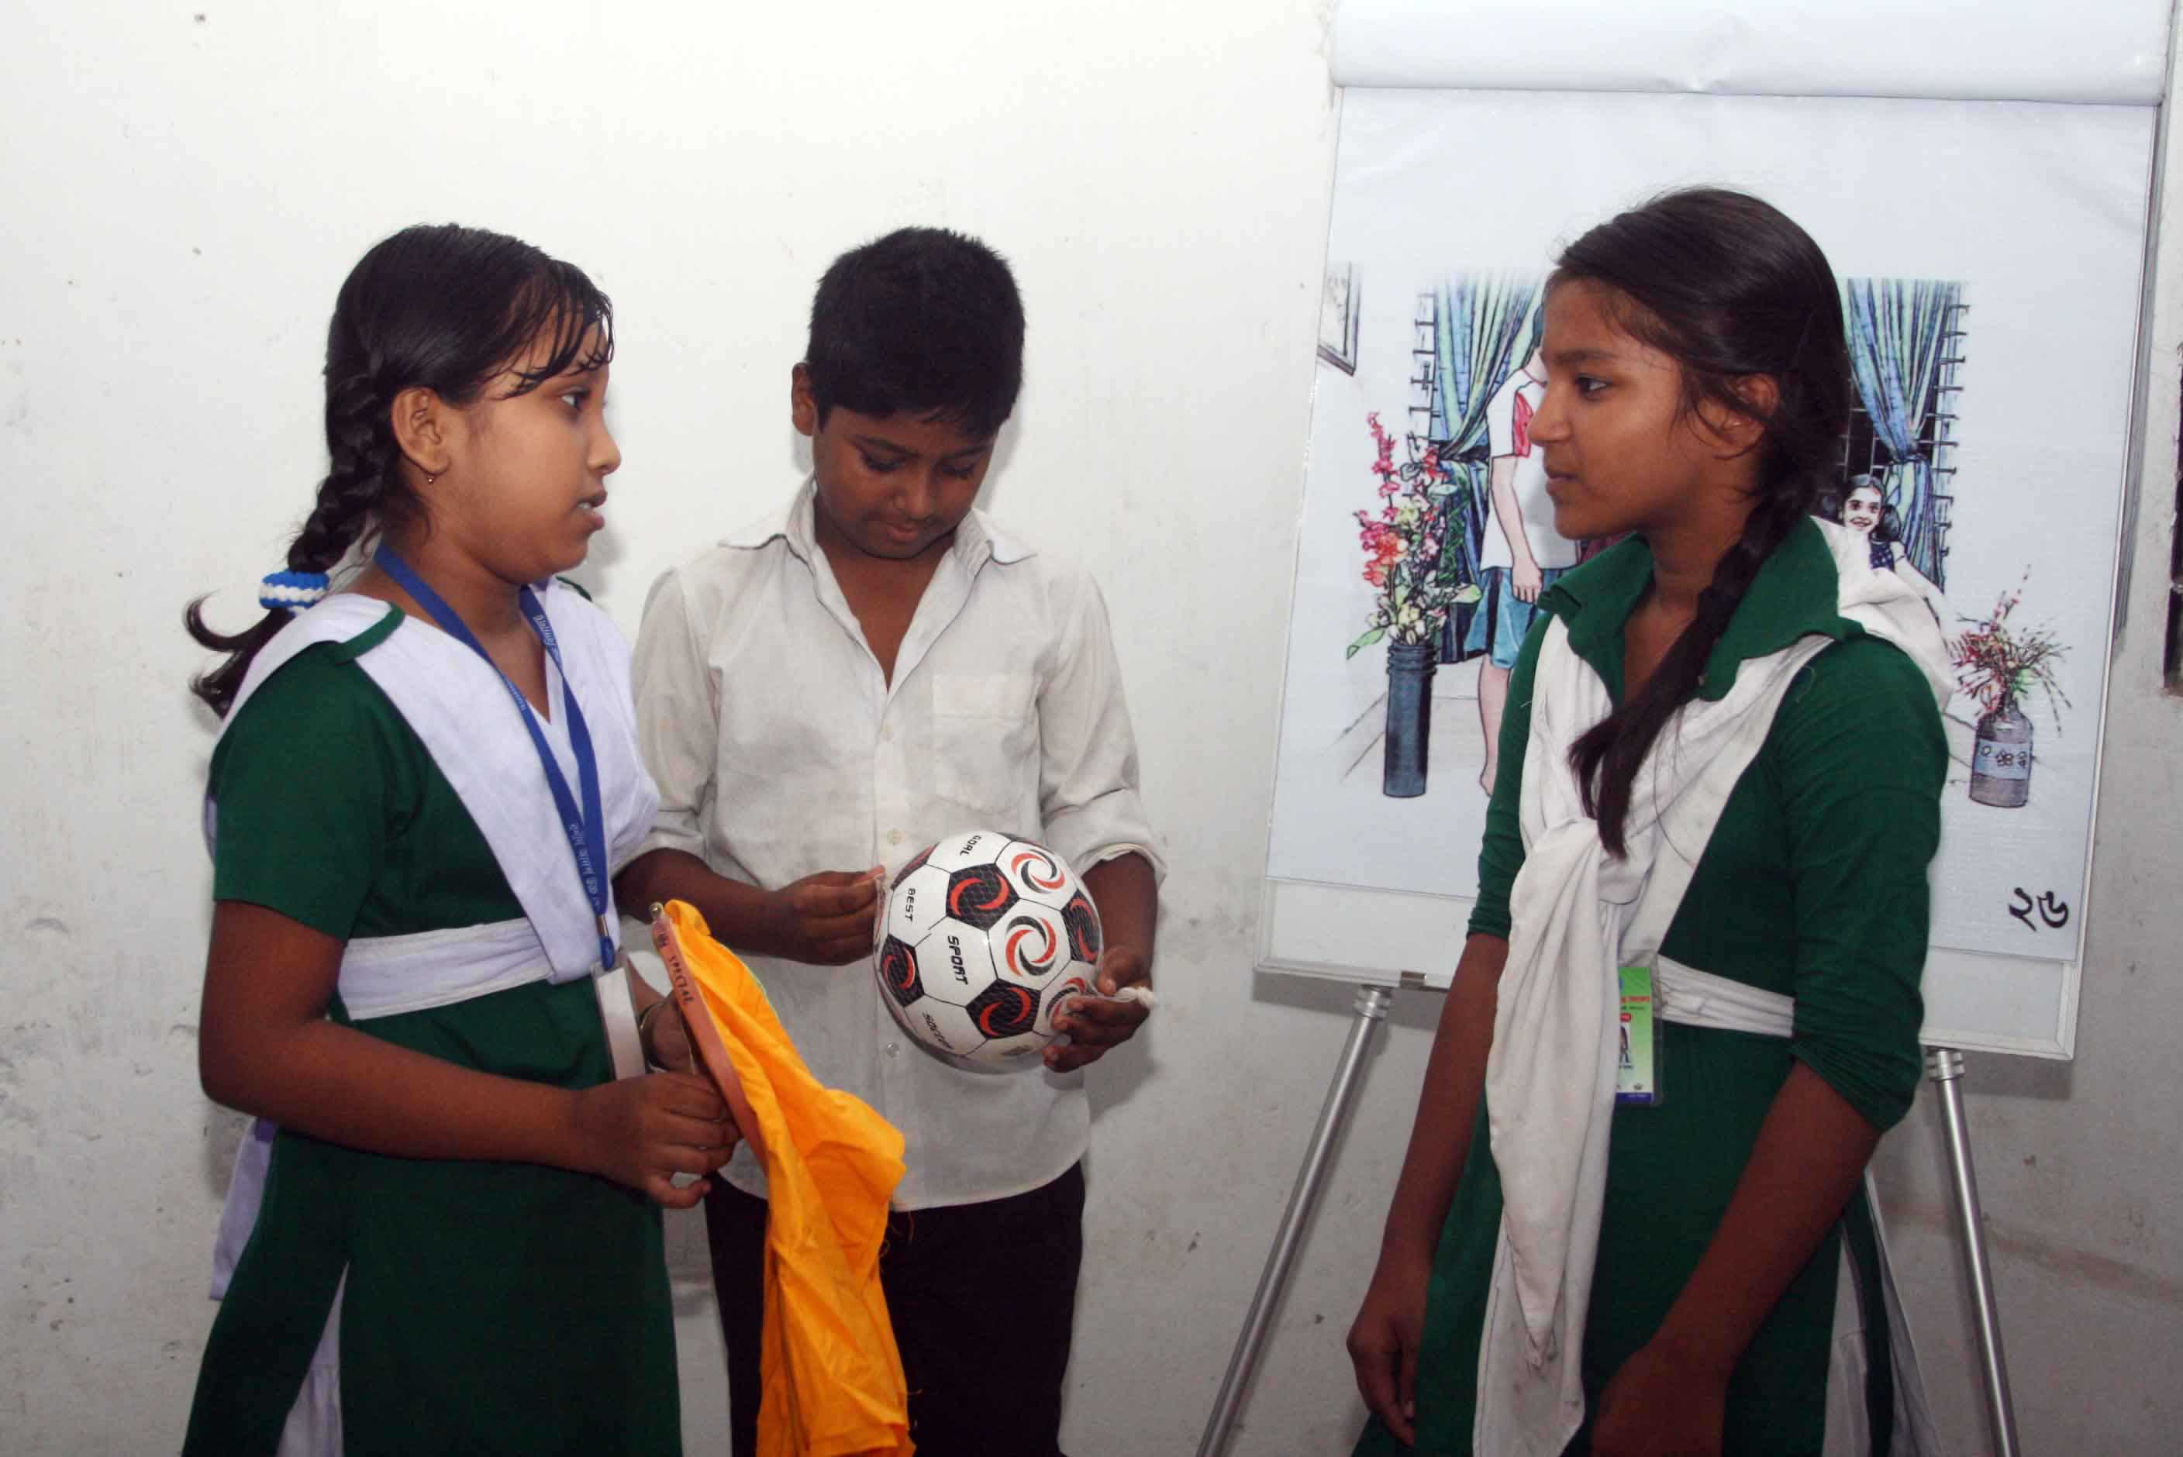
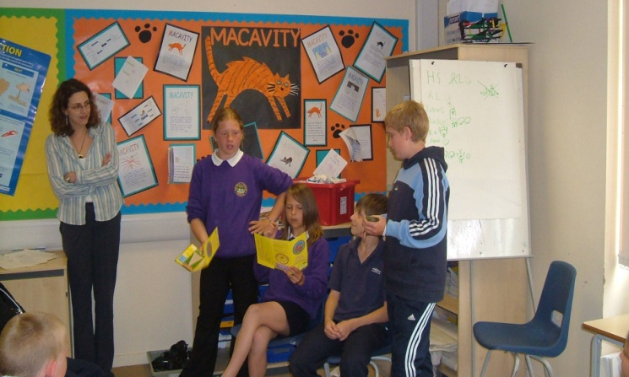
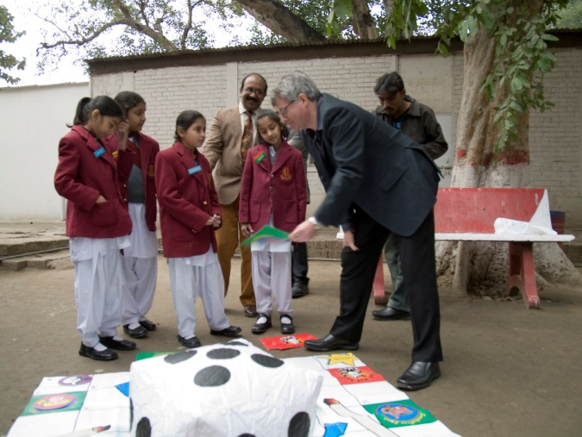
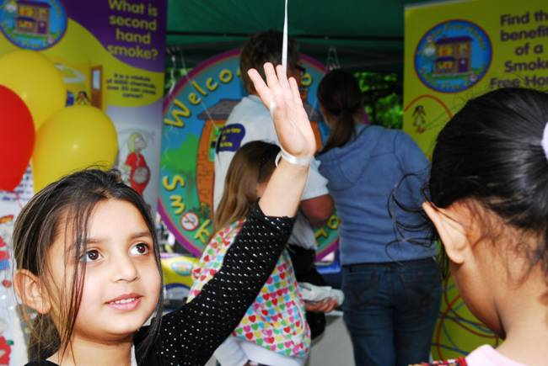
Schools

Slide 9
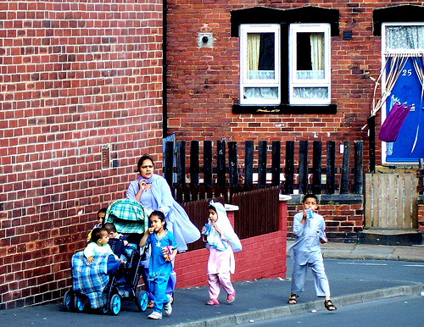
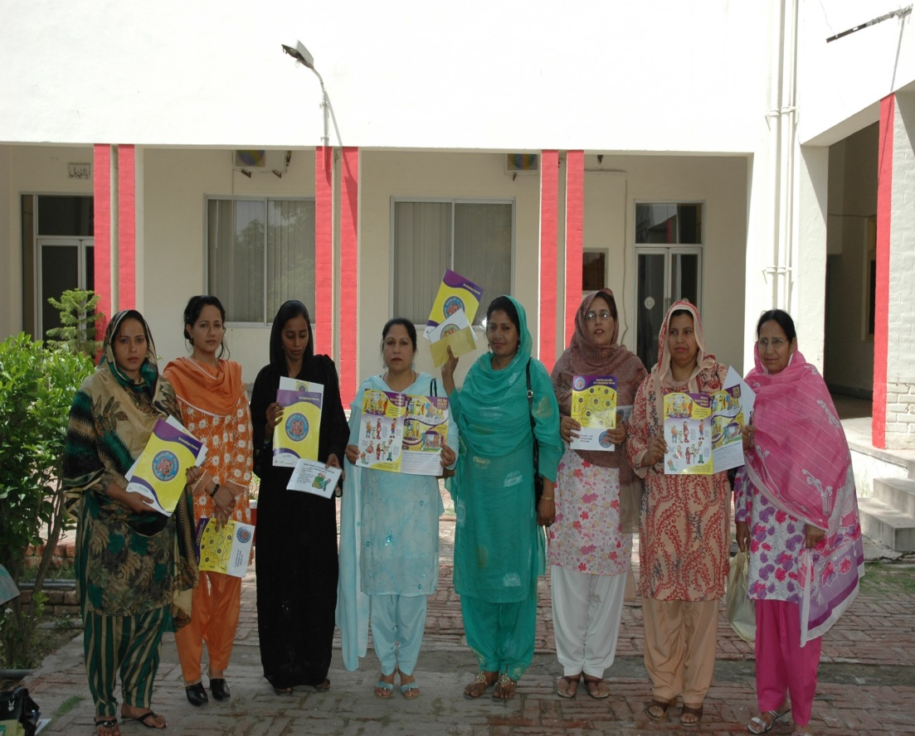
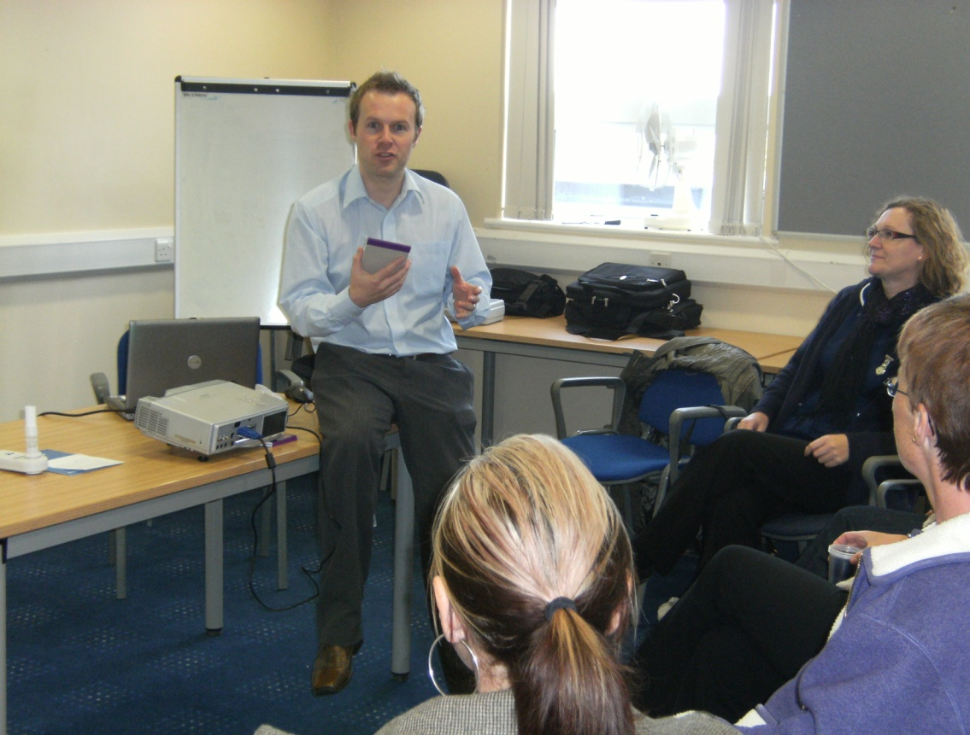
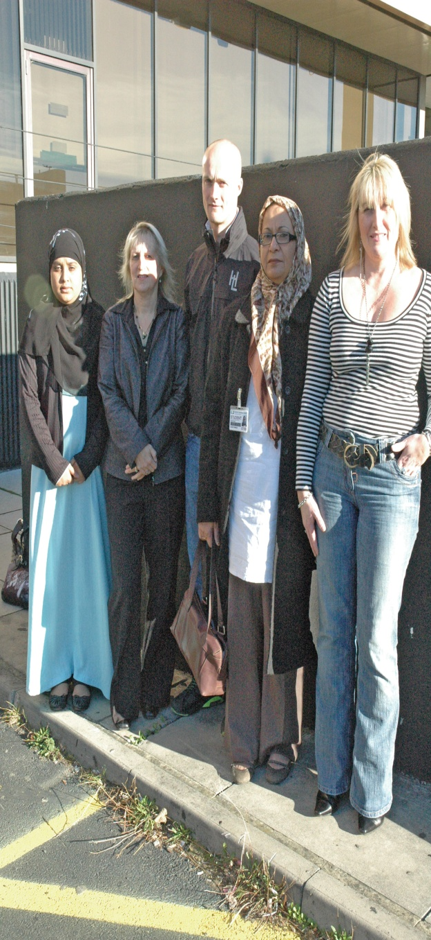
Antenatal settings

Slide 10
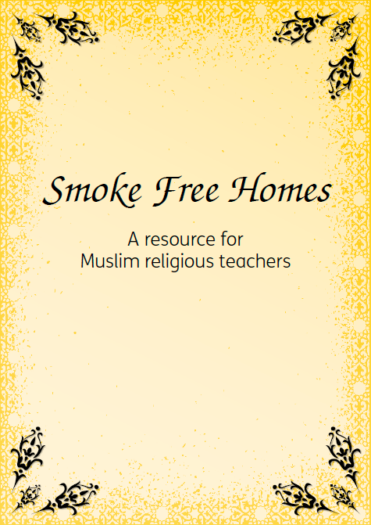
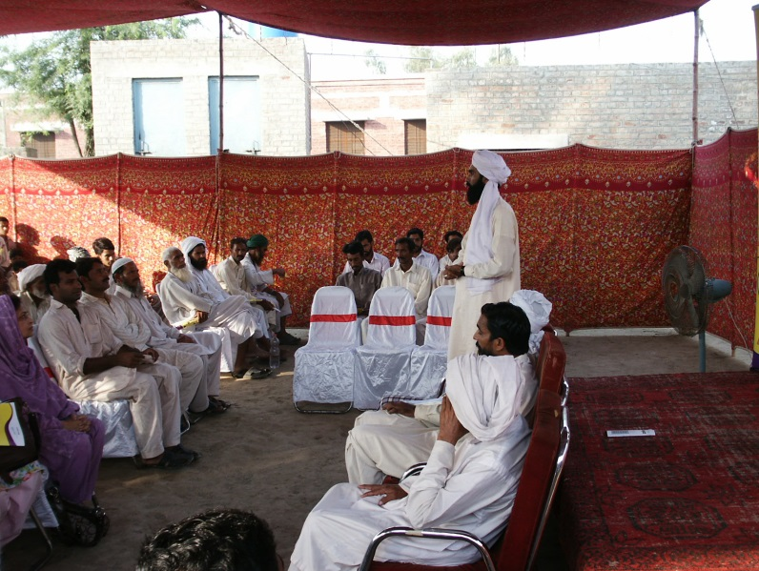
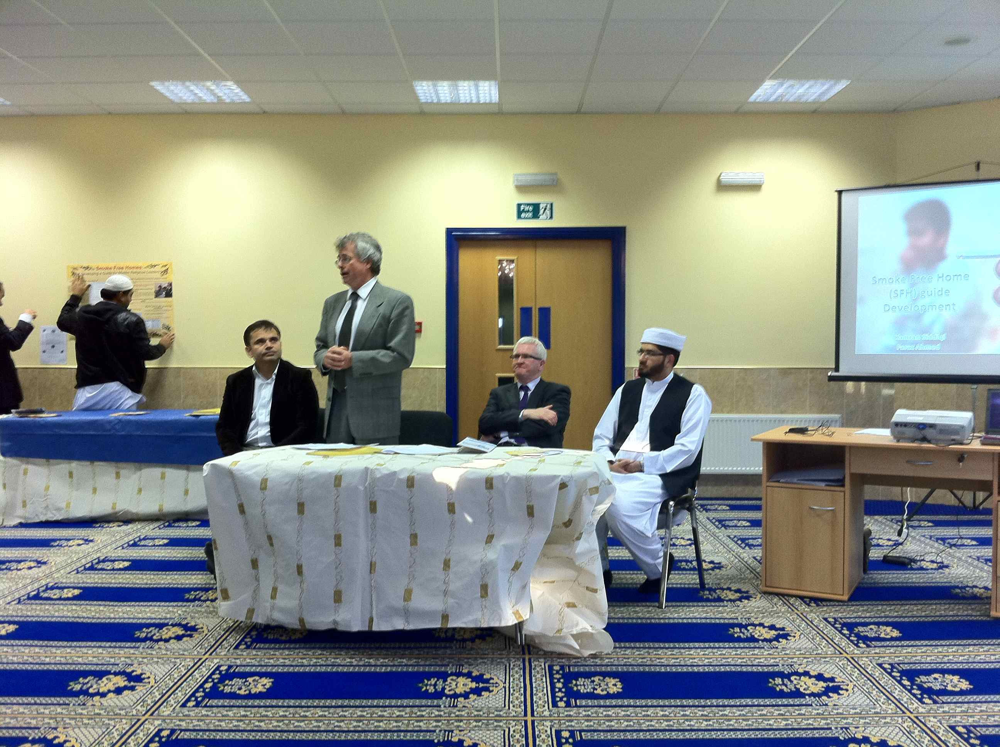
Community settings

Slide 11
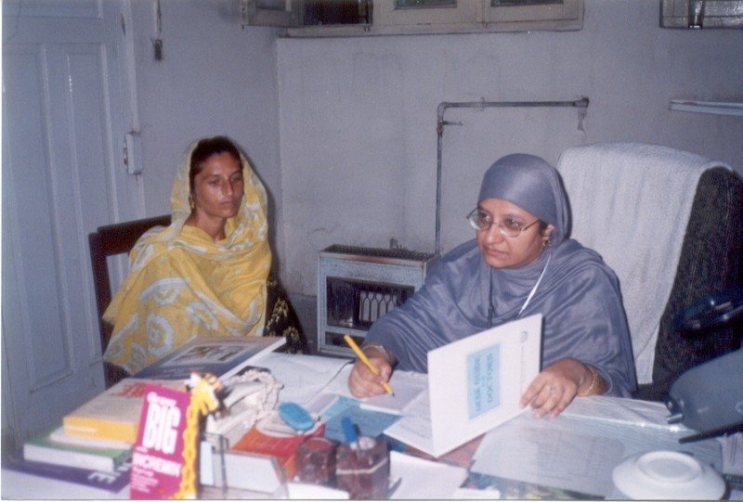
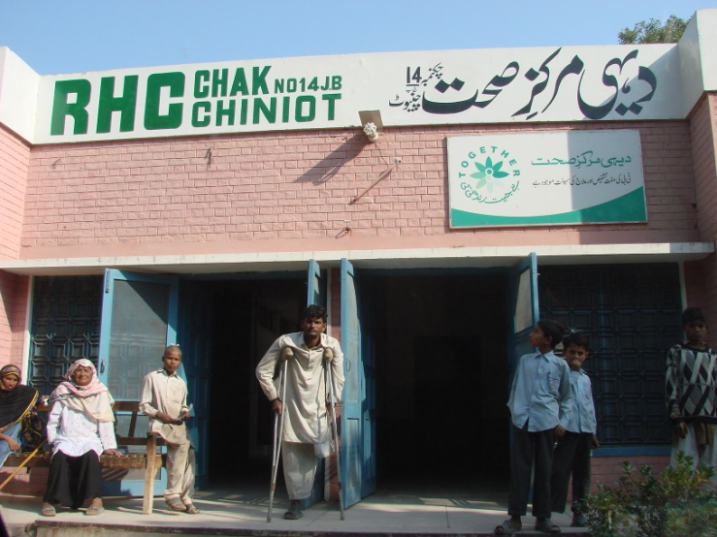
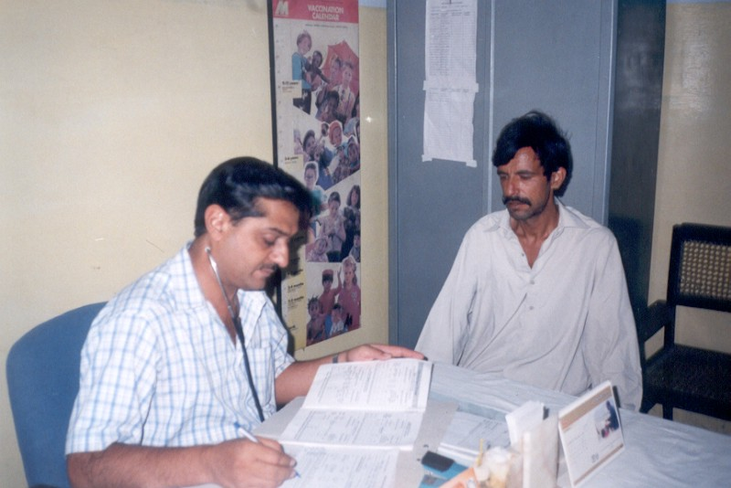
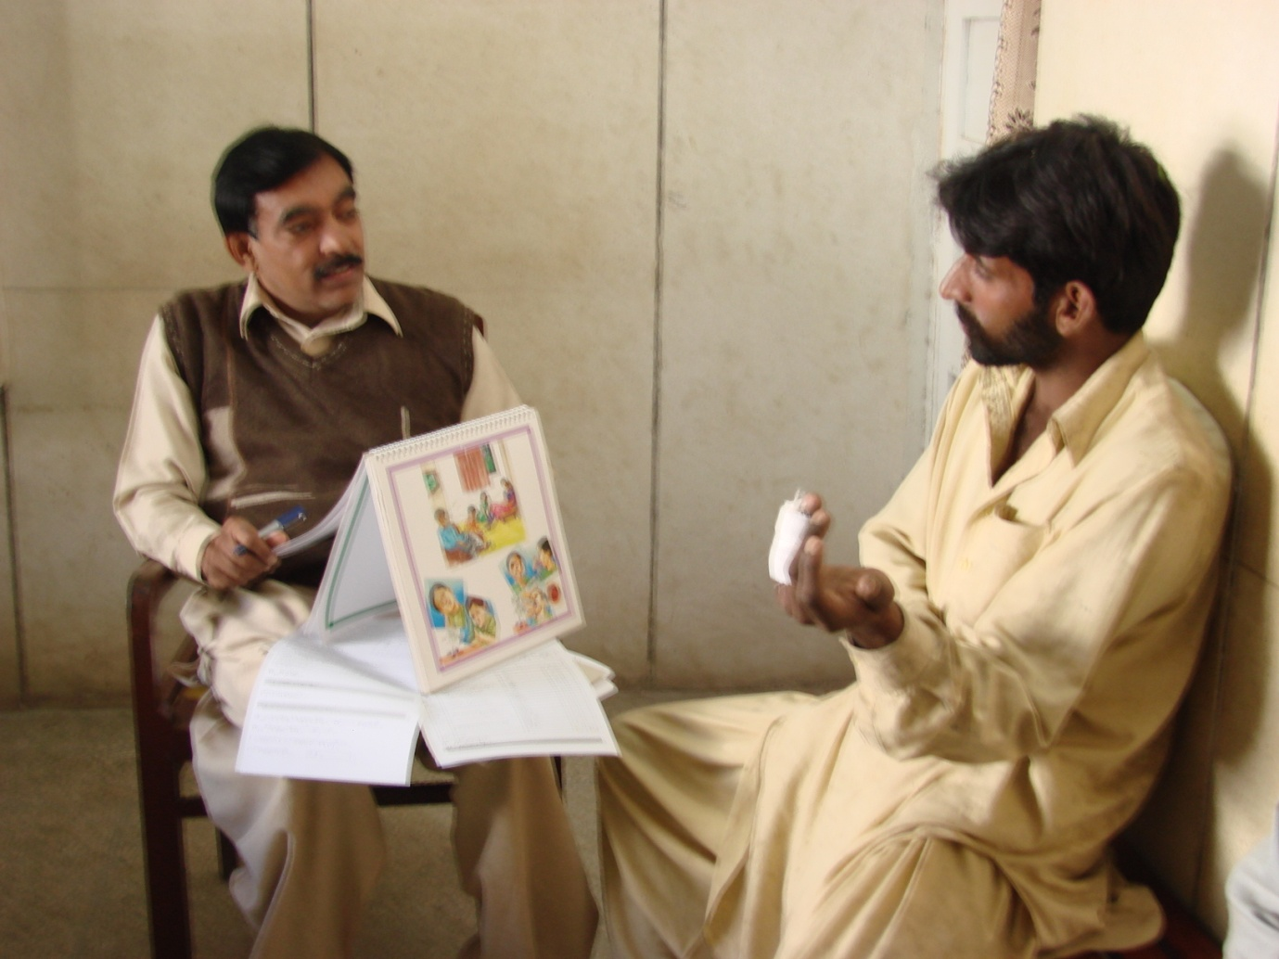
TB Programme

Slide 12
1: Facilitator to agent of change
S1 DISTAL OUTCOMES
Children go home and instigate discussion about smoking behaviour
Children always leave the room if someone is smoking

Slide 13
2: Agent of change to target population
Children go home and instigate discussion about smoking behaviour
Children always leave the room if someone is smoking

Slide 14
Results
 | Settings | Outcomes | Results
CLASS (Bangladesh) | Primary schools | Self-reported Smoking restrictions and visibility | 4.8 (95%CI: 2.6-9.0) and 3.9 (95%CI: 2.0-7.5)
MLASS (UK) | Antenatal appointments | Saliva cotinine | Poor recruitment and lack of interest
TBLASS (Pakistan) | TB clinics | Urine cotinine | (71% [95% CI 61-79%]) and (76% [95% CI 67-83%])
MCLASS (UK) | Mosques | Saliva cotinine | No evidence of a difference (-0.02, 95%CI -1.28-1.23, p=0.97)

Slide 15
Analysis (assumptions)
 | Facilitator of change ➔ Agent of change
 | Understanding | Acceptance | Motivation | Capacity to act | Action
CLASS (Bangladesh) | + | ++ | ++ | + | ++
MLASS (UK) | + | - | - | - | -
TBLASS (Pakistan) | + | ++ | ++ | + | ++
MCLASS (UK) | + | + | - | - | -
 | Agent of change ➔ Target population

Slide 16
Future direction
 | Settings | Future research | Other outcomes
CLASS (Bangladesh) | Primary schools | Definitive trial | Clinical and educational outcomes
MLASS (UK) | Antenatal appointments | In a different context (India) | Birth & development outcomes
TBLASS (Pakistan) | TB clinics | Definitive trial | TB outcomes
MCLASS (UK) | Mosques | Revise the intervention | ?

Slide 17
Summary
An intervention may work in one setting but not in another
Intervention logic model is useful to understand the reasons
Redefine your assumptions and refine your intervention
…..but don’t give up……….

Slide 18
References
Shah et al. Muslim Communities Learning About Second-hand Smoke (MCLASS): a pilot randomised controlled trial and cost-effectiveness analysis. Npj. Prim C Resp Med (2015) – in print
Huque et al. Children Learning About Second-hand Smoking (CLASS): a feasibility cluster randomised controlled trial. Nicotine Tob Res (2015) doi: 10.1093/ntr/ntv015.
Safdar et al. Tuberculosis patients learning about second-hand smoke (TBLASS): results of a pilot randomised controlled trial. International Journal of Tuberculosis and Lung Diseases. 2015; 19(2):237-243.
Alwan et al. Can a community-based 'Smoke Free Homes' intervention persuade families to apply smoking restrictions at homes? Journal of Public Health. 2011; 33 (1): 48-54
Siddiqi et al. ‘Smoke Free Homes’: An intervention to reduce second-hand smoke exposure in households. International Journal of Tuberculosis and Lung Diseases. 2010; 14 (10): 1336-1341

